Slide 1
ELECTRICAL SCIENCE-1
(15B11EC111)
Unit-3
Network Theorems
(Superposition Theorem, Thevenin’s Theorem, Norton’s Theorem, Maximum Power Transfer Theorem)
Lecture-1
Dr. Abhishek Kashyap
Assistant Professor (Senior Grade, JIIT Noida)

Slide 2
Topics to be Discussed
Network Theorems
Linearity Property
Superposition Theorem
Problem
References

Slide 3
Network Theorems
To handle the complex circuits, engineers have developed some theorems like Superposition Theorem, Thevenin’s Theorem, Norton’s Theorem, Maximum Power Transfer Theorem.
Since these theorems are applicable to linear circuits, we first discuss the concept of circuit linearity.

Slide 4
Linearity Property
Linearity is the property of an element describing a linear relationship between cause and effect.
The property is a combination of both the homogeneity (scaling) property and the additivity property.
The homogeneity property requires that if the input is multiplied by a constant, then the output is multiplied by the same constant.
The additivity property requires that the response to a sum of inputs is the sum of the responses to each input applied separately.
Resistor is a linear element because the voltage-current relationship satisfies both the homogeneity and the additivity properties.
In general, a circuit is linear if it is both additive and homogeneous.
A linear circuit consists of only linear elements, linear dependent sources, and independent sources.

Slide 5
Superposition Theorem
The superposition principle states that the voltage across (or current through) an element in a linear circuit is the algebraic sum of the voltages across (or currents through) that element due to each independent source acting alone.
To apply the superposition principle, we must keep two things in mind:
We consider one independent source at a time while all other independent sources are turned off. This implies that we replace every voltage source by 0 V (or a short circuit), and every current source by 0 A (or an open circuit). This way we obtain a simpler and more manageable circuit.
Dependent sources are left intact because they are controlled by circuit variables.

Slide 6
Superposition Theorem
With these in mind, we apply the superposition principle in three steps:
Turn off all independent sources except one source. Find the output (voltage or current) due to that active source.
Repeat step 1 for each of the other independent sources.
Find the total contribution by adding algebraically all the contributions due to the independent sources.

Slide 7
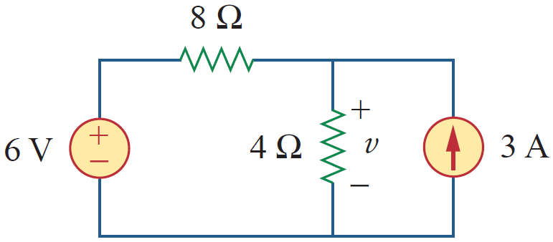
Problem
Use the superposition theorem to find v in the circuit of Fig.

Slide 8
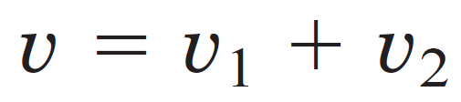
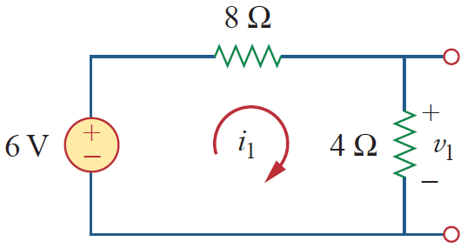

Problem - Solution
Since there are two sources, let
where v₁ and v₂ are the contributions due to the 6-V voltage source and the 3-A current source, respectively.
To obtain v₁ we set the current source to zero, as shown in Figure.
Applying KVL to the loop gives
Thus

Slide 9
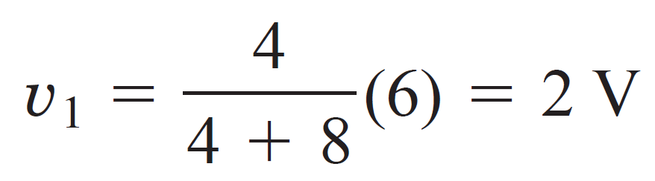
Problem - Solution
We may also use voltage division to get v₁ by writing

Slide 10
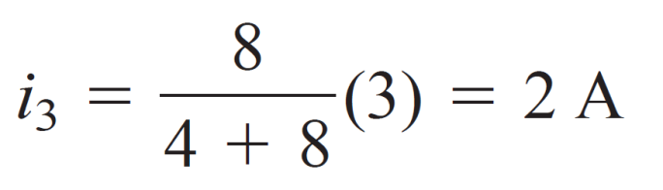
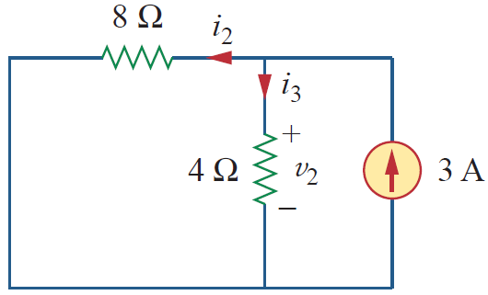
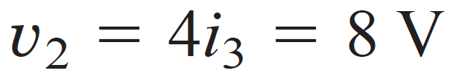
Problem - Solution
To get v₂ we set the voltage source to zero, as in Figure.
Using current division,
Hence,
And we find

Slide 11
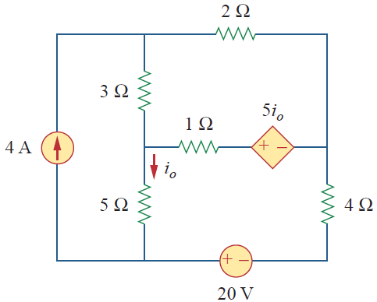
Problem
Find i₀ in the circuit of Figure using superposition.

Slide 12
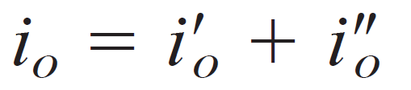


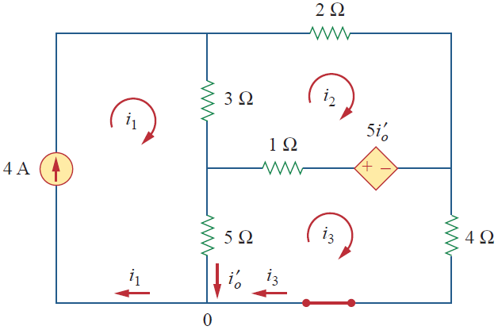

Problem - Solution
The circuit in Figure involves a dependent source, which must be left intact.
We let
where and are due to the 4-A current source and 20-V voltage source respectively.
To obtain we turn off the 20-V source so that we have the circuit in Figure.
We apply mesh analysis in order to obtain
For loop 1,
For loop 2,

Slide 13

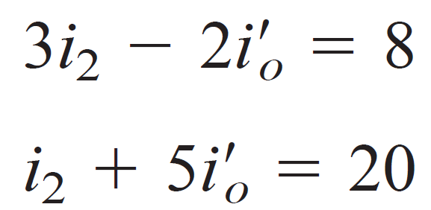
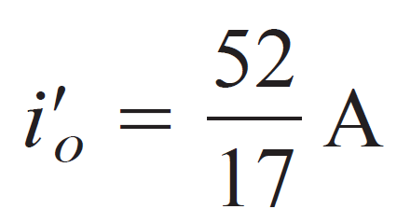
Problem - Solution
For loop 3,
But at node 0,
By substituting, we get
After solving, we get

Slide 14
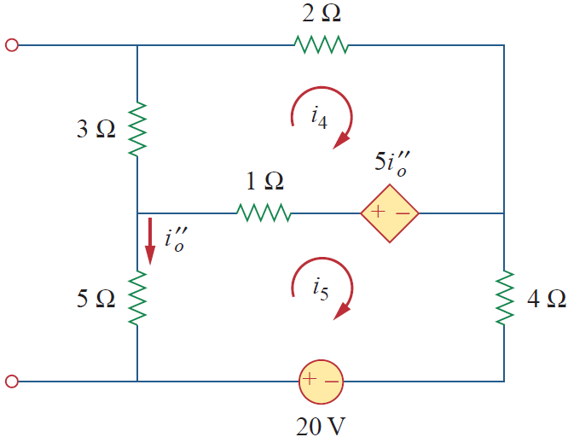

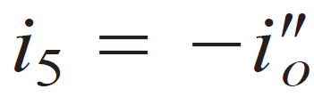
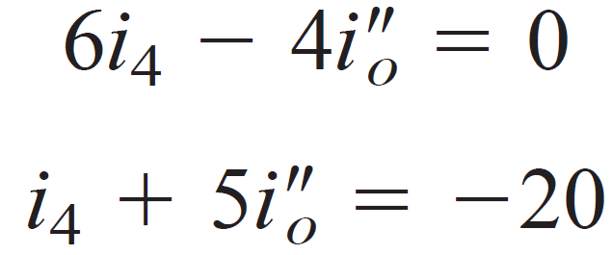
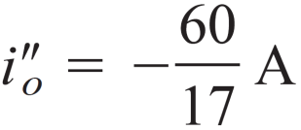
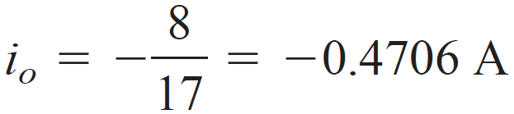
Problem - Solution
To obtain we turn off the 4-A current source so that the circuit becomes that shown in Figure.
For loop 4, KVL gives
and for loop 5,
But
Substituting this in Equations gives
which we solve to get
Finally, we get

Slide 15
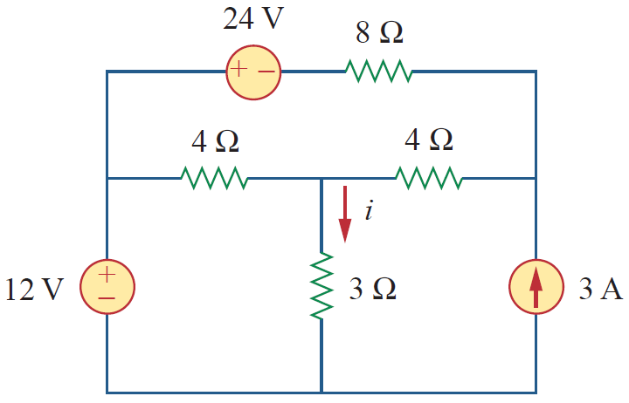
Practice Problem
For the circuit in Figure, use the superposition theorem to find i.
Ans: 2 A

Slide 16
References
R.C. Dorf and James A. Svoboda, “Introduction to Electric Circuits”, 9th ed, John Wiley & Sons, 2013.
D.C. Kulshreshtha, Basic Electrical Engineering, Revised 1st ed, Tata Mc Graw Hill, 2017.
V. K.Mehta, Rohit Mehta, Basic Electrical Engineering, 6th ed, S. Chand Publishing, 2012.

